Slide 1
CAPSTONE PROJECT
TITLE: Rwanda's Digital Transformation
N.CHARAN KUMAR
A.DINAKAR SAI
G.SIDHARDH

Slide 2

Empowering Youth Through Digital Skills Training
As part of Rwanda's digital transformation efforts, empowering the youth with essential digital skills is paramount. By providing training programs focused on coding, digital literacy, and entrepreneurship, Rwanda is shaping a tech-savvy workforce for the future.

Slide 3
Rwanda's Digital Transformation
Laying the Groundwork
1
Rwanda has made significant strides in building a robust digital infrastructure, investing heavily in fiber optic networks and expanding internet access nationwide.
2
Embracing e-Government
The government has implemented a range of e-government initiatives, digitizing public services and streamlining administrative processes to improve efficiency and transparency.
Driving Innovation
3
Rwanda has created an enabling environment for tech startups and entrepreneurs, establishing innovation hubs and providing support to foster a thriving digital ecosystem.

Slide 4

Rwanda's Digital Transformation
Rwanda is rapidly embracing digital technologies to integrate into the global economy and drive sustainable development. This digital transformation brings both opportunities and challenges as the country navigates increasing connectivity and cyber threats.

Slide 5
Integrating into the Global Economy through ICT
e-Government
Tech Hub
Digital Payments
Rwanda is digitalizing its public services to improve efficiency and citizen access.
Kigali Innovation City is becoming a regional hub for tech startups and innovation.
Rwanda's mobile money ecosystem is enabling greater financial inclusion.

Slide 6

Increasing Cyber Threats with Connectivity
1
Malware Attacks
Rwandan systems are vulnerable to malware that can disrupt critical services.
2
Data Breaches
Sensitive citizen and government data is at risk of unauthorized access.
3
Phishing Scams
Rwandans are targeted by fraudulent emails and messages to steal information.

Slide 7

Digitalization of Critical Infrastructure
Smart Utilities
Rwanda is digitizing its power, water, and transportation networks to improve efficiency.
e-Health
Telemedicine and digital medical records enhance healthcare access and quality.
Digital Education
Rwanda is integrating technology into its schools to modernize the learning experience.

Slide 8




Vulnerabilities in ICT Systems
Data Security
Inadequate encryption and access controls put sensitive information at risk.
Software Flaws
Unpatched software vulnerabilities can be exploited by cybercriminals.
Insider Threats
Malicious actors within organizations can misuse their access privileges.

Slide 9
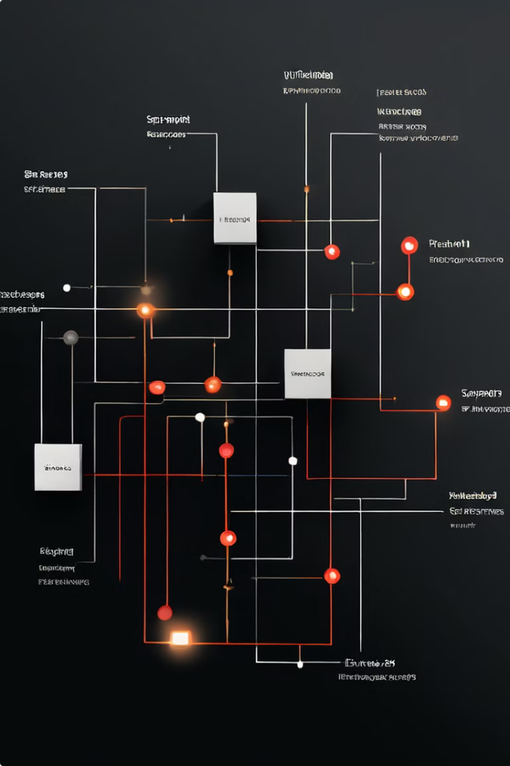



Robust Network Setup Necessity
Network Segmentation
Dividing the network into smaller, isolated segments can limit the spread of attacks.
Intrusion Detection
Monitoring for suspicious activity and quickly responding to threats is crucial.
Redundancy & Backups
Ensuring critical data and systems have redundant backups can minimize downtime.

Slide 10

Cybersecurity Challenges and Risks
Lack of Skilled Professionals
Difficulty Retaining Talent
Limited Cybersecurity Awareness
Outdated Legacy Systems
Insufficient Funding
Evolving Threat Landscape

Slide 11

Securing Rwanda's Digital Future
1
National Cybersecurity Strategy
Develop a comprehensive plan to address current and future cyber threats.
2
Capacity Building
Invest in training and upskilling Rwandan professionals in cybersecurity.
3
Public-Private Partnerships
Collaborate with the private sector to enhance the country's digital resilience.

Slide 12


